Slide 1
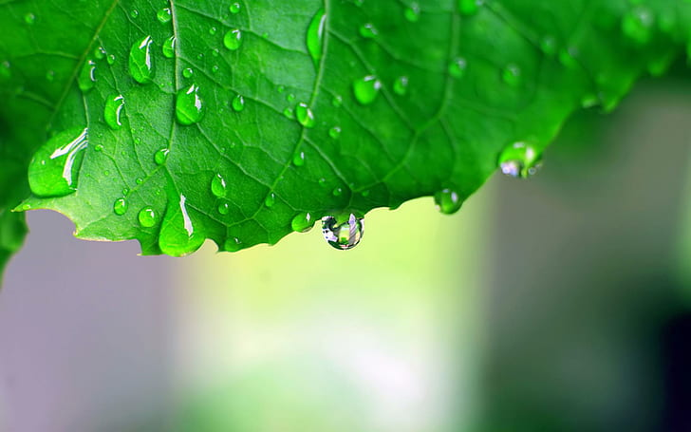
SEASON’S GREETINGS
May The Rains Way Away Your Worries And Bring New Beginning.
Have A Joyful And Peaceful And Peaceful Monsoon

